Slide 1

Project: Data Management
Data Acquisition and Cleaning
By Group 4:
Sanath Haritsa
Aniket Ghetla
Spoorti Basarkod Math
Kshema Iliger
Vandit Bhalla

Slide 2
Deliverables
In order to fulfill the project goals the following tasks were needed to be completed:
Task | Deadline | Member responsible
Dataset Collection | 23-02-2024 | Sanath Haritsa
Data Profiling | 27-02-2024 | Spoorti Basarkod Math
Data Quality | 29-02-2024 | Aniket Ghetla
Data Uncleaning | 02-03-2024 | Kshema Iliger
Data Cleaning | 04-02-2024 | Vandit Bhalla
Presentation | 05-03-2024 | All Members
2

Slide 3


What do you do on weekends ?
Is this you every Friday night ?
3

Slide 4
What do you do on weekends ?
Is this you every Friday night ?
!
It’s alright to drink Alcohol but one should do so while being aware of its effects.
3

Slide 5

Introduction
The “Harmony Hope Foundation”, a non-profit organization, aims to raise awareness about the risks associated with alcohol consumption and the related health conditions.
The Harmony Hope Foundation is dedicated to conducting an in-depth analysis of alcohol consumption patterns across various age groups and geographical locations to strategically deploy targeted awareness campaigns.
Data Source:
Centers for Disease Control and Prevention (CDC) is USA’s leading science-based, data-driven, service organization that protects the public’s health.
4

Slide 6
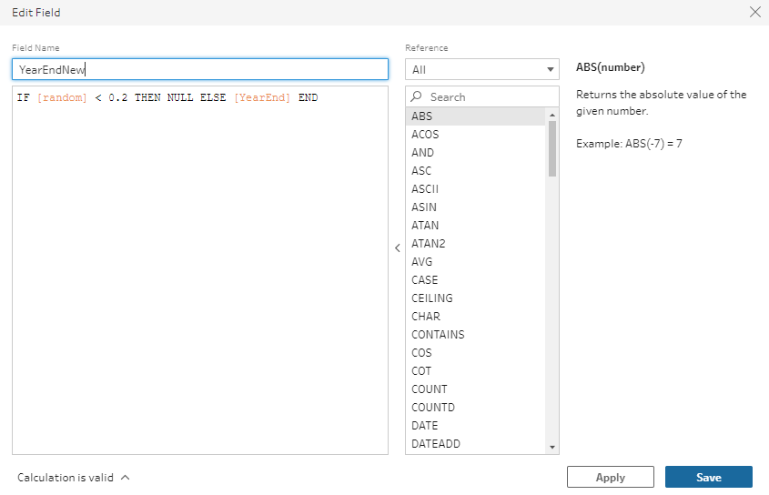
Data Uncleaning
Missing Values
Create RANDOM() field using New Calculated field
Create a new calculated field using IF [Random] < 0.2 THEN NULL ELSE [Your Field] END (if we want threshold as 20%)
Delete the old column
Rename the new column with the old column's name
Delete the RANDOM field
7

Slide 7
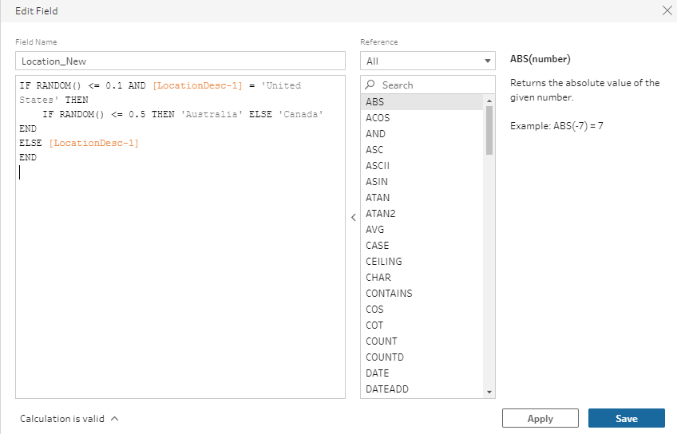
Data Uncleaning
Incorrect Values
Create a new calculated field using
IF RANDOM() <= 0.1 AND [LocationDesc-1] = 'United States' THEN IF RANDOM() <= 0.5 THEN 'Australia' ELSE 'Canada' END ELSE[LocationDesc-1] END
Delete the old column
Rename the new column with the old column's name
Delete the RANDOM field
8

Slide 8
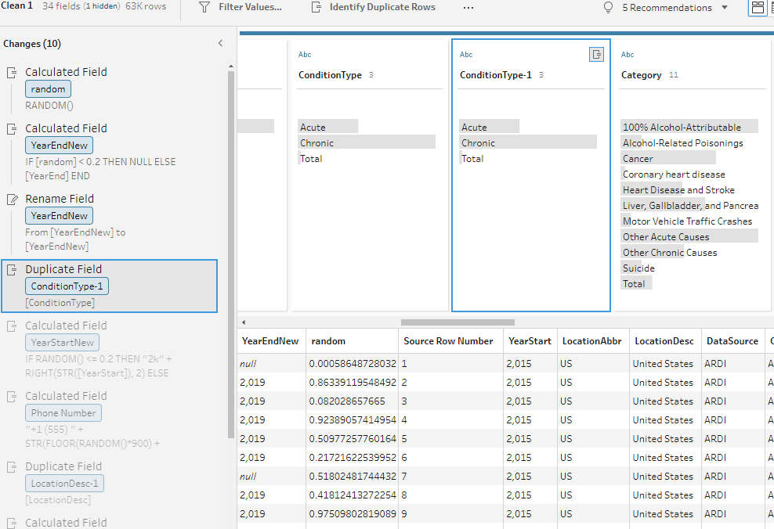
Data Uncleaning
Duplicate Entries
Select the column, click on the 3 dots and select ‘Duplicate Field’
This will give you a redundant field
9

Slide 9
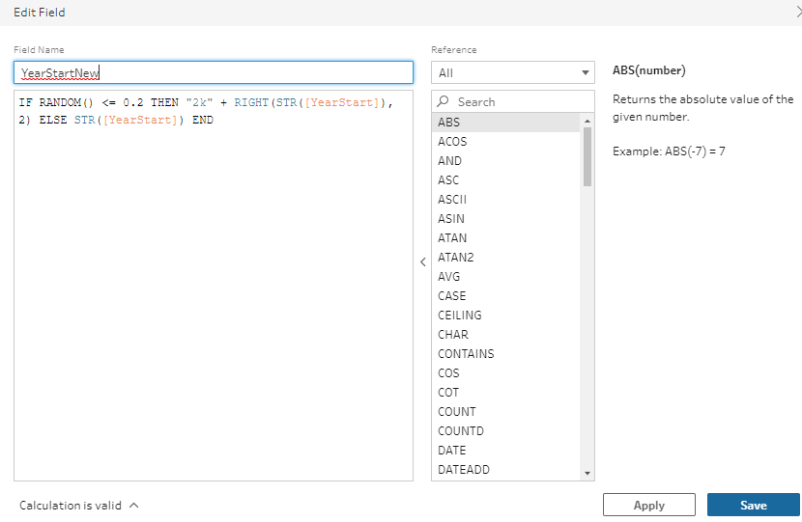
Data Uncleaning
Inconsistent Formats
Column changed ‘YearStart’
IF RANDOM() <= 0.2 THEN "2k" + RIGHT(STR([YearStart]), 2) ELSE STR([YearStart]) END
10

Slide 10
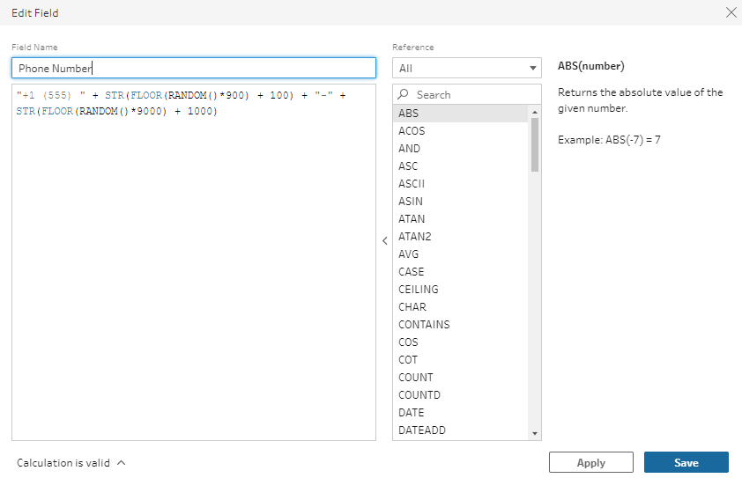
Data Uncleaning
Privacy Violation
Adding sensitive data to the dataset like Phone Numbers
"+1(555)"+STR(FLOOR(RANDOM()*900) +100)+"-"+ STR(FLOOR(RANDOM()*9000)+1000)
11

Slide 11
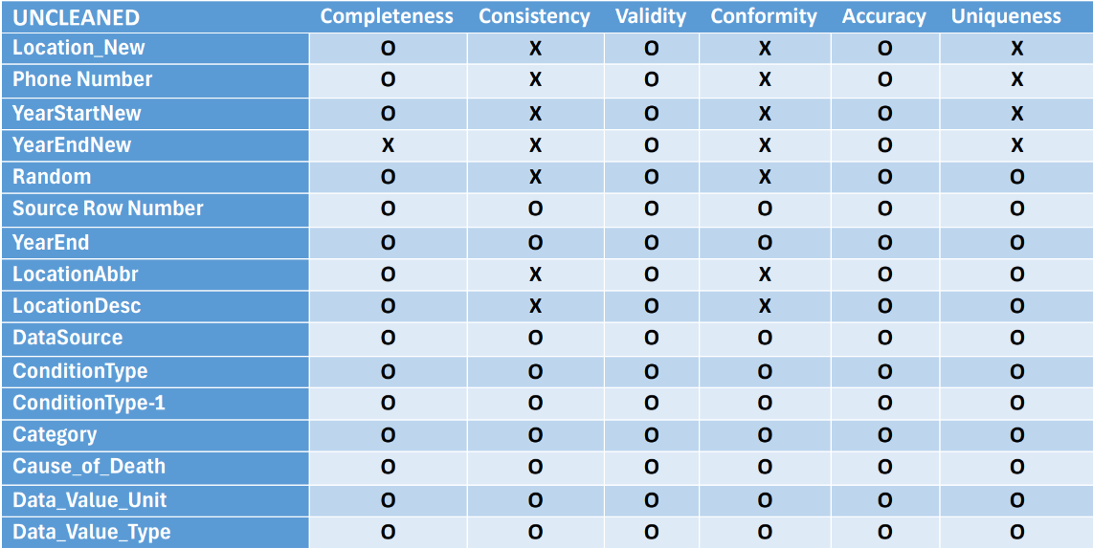
Data Profiling
5

Slide 12
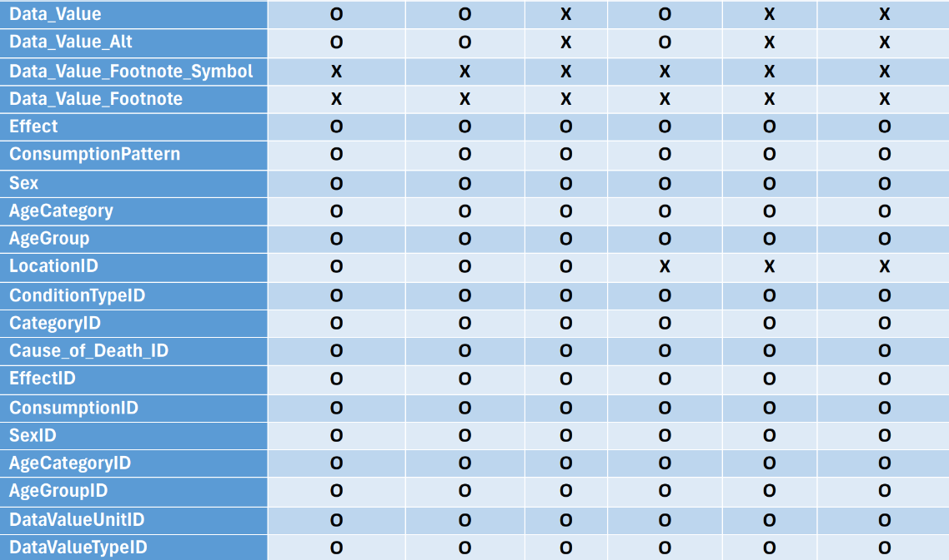
Data Profiling
6

Slide 13
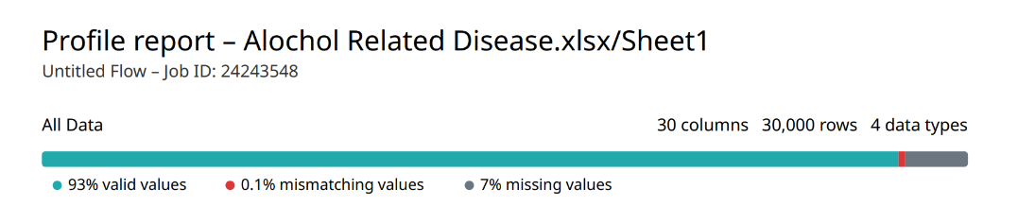
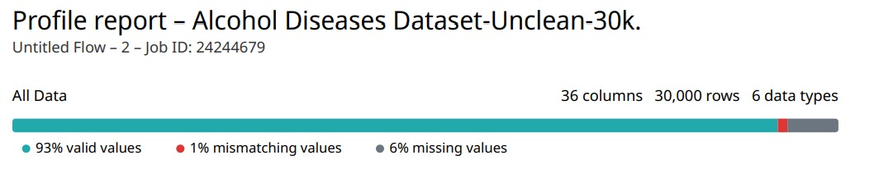
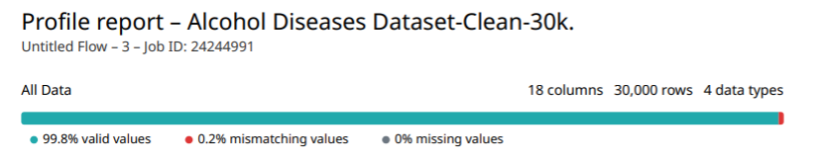
Data Profiling
6

Slide 14
Data Quality
Data quality refers to the degree to which data sets are accurate, complete, reliable, relevant, and timely, meeting the requirements of their intended use
Key data qualities:
Completeness
Consistency
Validity
Accuracy
Conformity
Currency
Timeliness
Uniqueness
12

Slide 15
Data Quality
Completeness:
"YearEndNew" has 5,974 missing values, accounting for approximately 20.01% of the column. This indicates a significant portion of data is missing from this column.
“Data Value_Footnote_Symbol” and “Data_Value_Footnote” are completely missing, with 100% of their values being null. These columns do not contribute any useful information in their current state and may be considered for removal or require further investigation to determine if the missing data can be sourced or inferred.
Given these findings, the dataset's overall completeness is fairly high, with the exception of the “YearEndNew”, “Data_Value_Footnote_Symbol”, and “Data_Value_Footnote”.
13

Slide 16
Data Quality
Conformity:
Data is following the set of standard data definition.
Data_Value ranges from -41,647 to 3,713,177. The presence of negative values in this context may indicate data entry errors or specific encoding for certain conditions within the dataset. This wide range also suggests a significant variance in the data, requiring understanding the context of these values to determine conformity.
Consistency:
Overall, the dataset looks highly consistent there are few exceptions such as duplication of “Data_Value” column.
Since our dataset has been gathered from a single data source we believe the dataset is consistent.
14

Slide 17
Data Quality
Uniqueness:
The Source Row Number column contains 30,000 unique values, which matches the total number of entries in the dataset. This finding indicates that the Source Row Number serves as a unique identifier for each record, confirming a high level of uniqueness within the dataset at least in terms of record identification.
Validity:
Validity of the dataset is high as most of the data is in the specified format as required. One exception is The data_Value column which contains 1,720 entries with negative values.
To ensure the validity of the dataset for analysis or application purposes, these negative values should be investigated further.
15

Slide 18
Data Quality
Currency:
The dataset primarily covers data up to the year 2019, as indicated by the YearEndNew field which consistently shows 2019 across its entries. The YearStartNew field contains two distinct representations for the year 2015: '2015' and '2k15'. This variation suggests a potential inconsistency in data entry but confirms that the dataset includes data starting from the year 2015.
Timeliness:
As we have seen in currency the data is collected up to 2019 which means the dataset lacks timeliness
It also depends upon type of analysis we need to perform, for Historical Analysis or Trend Observation its timeliness is appropriate but for informed decisions or analyses reflecting current conditions data cannot be used.
16

Slide 19
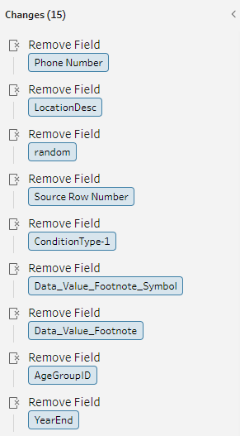
Data Cleaning
Remove unwanted columns
17

Slide 20
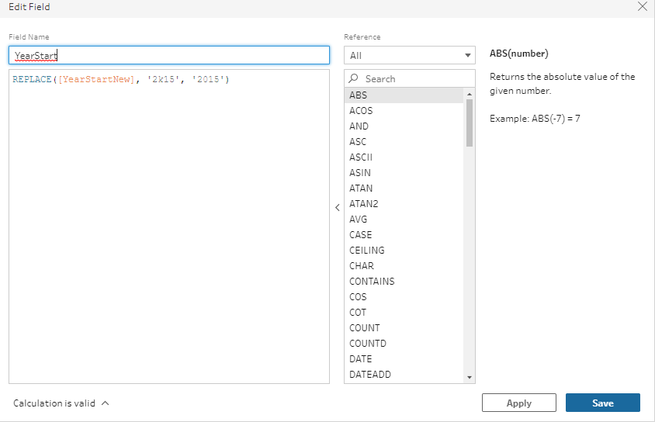
Data Cleaning
Standardize columns
YearStart -REPLACE([YearStartNew], '2k15', '2015')
18

Slide 21
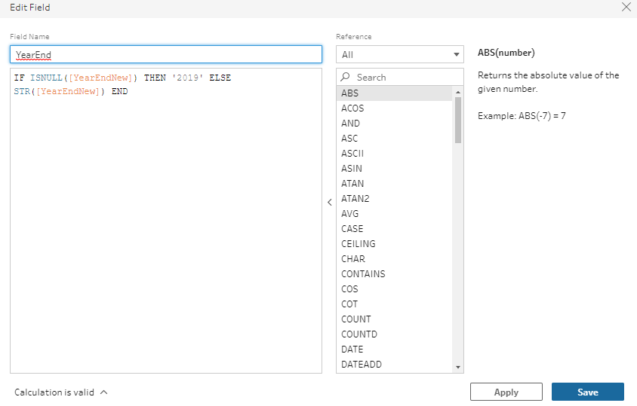
Data Cleaning
Replace Null values
IF ISNULL([YearEndNew]) THEN '2019' ELSE STR([YearEndNew]) END
19

Slide 22

Data Cleaning
Correct mapping
Replacing location name with correct name using location id -IF [LocationID] = 99 THEN 'United States' ELSE [Location_New] END
20

Slide 23
Conclusion
We explored different tools and methods to unclean as well as clean a dataset.
Data profiling and exploring helps avoid additional production costs that can incur if raw data is used.
Having a high-quality dataset is a crucial aspect of the data analysis pipeline, a bad dataset can lead to inaccurate results.
21

Slide 24

Thank You
Thank You
6

